Slide 1
Parkinson Disease Detection Project
Project presented by Team OpenCv

Slide 2
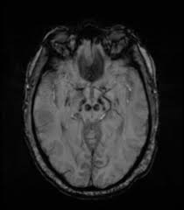
Team Members
Arinze Nwuba – Team Leader
Orih Ijeoma – Assistant Team Leader
Godspower Iheanacho- Query Analyst
Rashidat Sikiru – Member
Yakubu Nabilat Titilayo-Member
Mfoniso Udo – Member
Omowumi Taoheed Adewale- Member
Oluwafadejimi Kadiri – Member
Happiness Jacob – Member
Sunkanmi Otitolaye – Member
Oluwasegun Olujemibola - Member
Team OpenCV

Slide 3
Project Statements
Parkinson Disease is a progressive neurological disorder that affects the nervous system. This disease is marked by the decrease in dopamine level. Although, the exact cause of Parkinson disease is not fully understood, It is believed to be related to a combination of genetic and environmental factors.
As technology expands , Machine Learning provides an exciting opportunity for Healthcare to improve the diagnoses of patients with Parkinson disease by making predictions and draw critical patterns from the patients data. With this, Data Scientists are able to make accurate and timely diagnoses of patients suffering from Parkinson Disease which can improve patient outcomes.
A Parkinson Detection Analysis is a typical classification problem within the domain of Supervised Machine Learning.

Slide 4
Project WorkFlow
Machine Learning
(Training model and evaluation)
Data from web
Data Wrangling
Exploratory Data Analysis
Model Deployment

Slide 5
Data Description
The datasets has about 195 rows and 24 columns.
Column Name | Description
name | ASCII subject name and recording number
MDVP:Fo(Hz) | Average vocal fundamental frequency
MDVP:Fhi(Hz) | Maximum vocal fundamental frequency
MDVP:Flo(Hz) | Minimum vocal fundamental frequency
NHR,HNR | Two measures of ratio of noise to tonal components in the voice
status | Health status of the subject (one) - Parkinson's, (zero) - healthy
PDE,D2 | Two nonlinear dynamical complexity measures
DFA | Signal fractal scaling exponent
spread1,spread2,PPE | Three nonlinear measures of fundamental frequency variation
MDVP:Shimmer,MDVP:Shimmer(dB),Shimmer:APQ3,Shimmer:APQ5,MDVP:APQ,Shimmer:DDA | Several measures of variation in amplitude

Slide 6
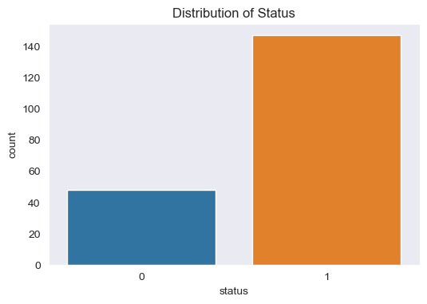
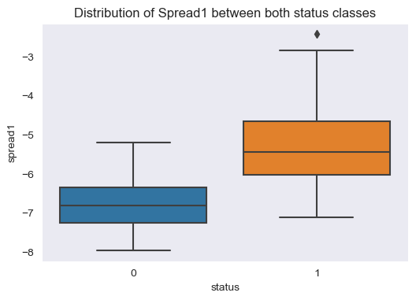
Exploratory Data Analysis
The illustrative graph above shows that there is class imbalance for the target variable ‘status’, with 75.5% of patients are with Parkinson while the remaining 24.6% are don’t have Parkinson. This datasets needs to be balanced before developing ML algorithm for classification.
The boxplots shows that patients with Parkinson disease have higher median value in spread1 than those without it.

Slide 7
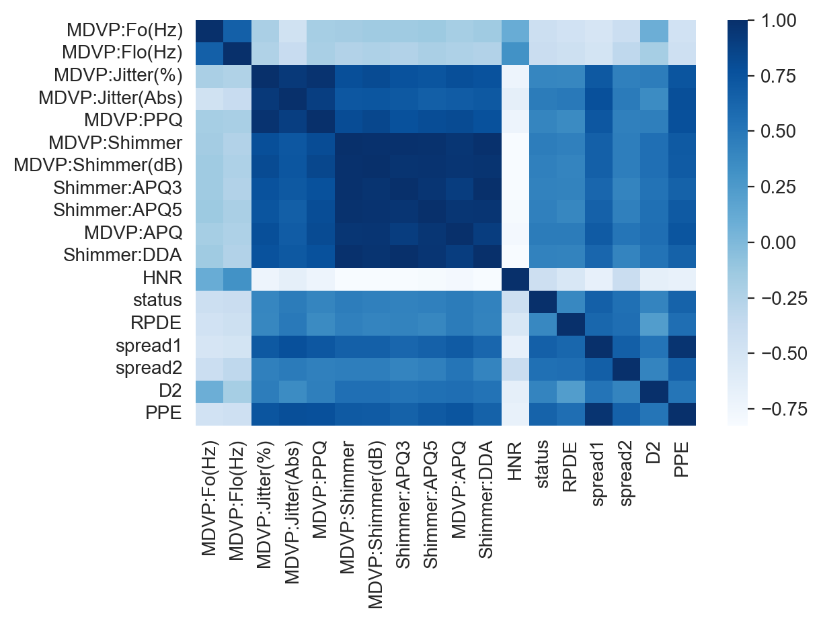
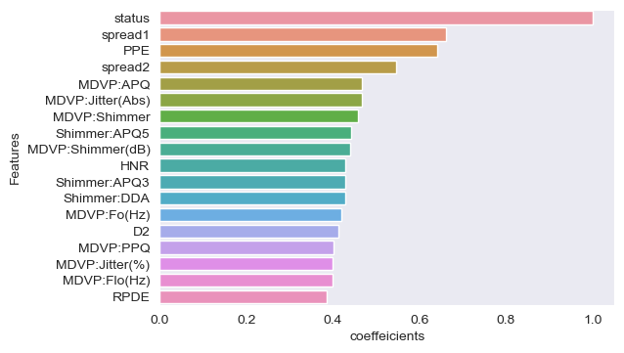
Feature Extraction
The above heatmap shows how correlated the features are to each other while the barplot shows how the features are to the status.
At the end ,we dropped five features that were least correlated.

Slide 8
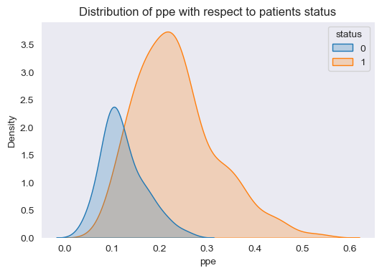
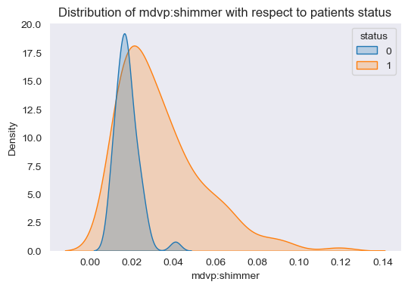
Distribution of ppe and mdvp with respect to the patients status
From the first kdeplot, we could see that patients without Parkinson disease, the ppe is clustered more at 0.1 while on the other hand patients with Parkinson has ppe clustered more within the 0.2 and 0.3. We could it also have more variance . This means that Parkinson are discovered more on patient with high ppe.
From the second kdeplot, we could see that patients with high mdvp has greater tendency of been diagnose with Parkinson.

Slide 9
Data Wrangling Process
01
03
02
Drop some columns
Some numeric features such as 'MDVP:Fhi(Hz)’, 'NHR','DFA’, 'Jitter:DDP’ and 'MDVP:RAP dropped as they were not needed in the model due to low correlation.
Scaling
Minmax scaler function was used to scale the features.
Handling Class Imbalance
Treated the class imbalance by oversampling using the resampling function from the scikit library.

Slide 10
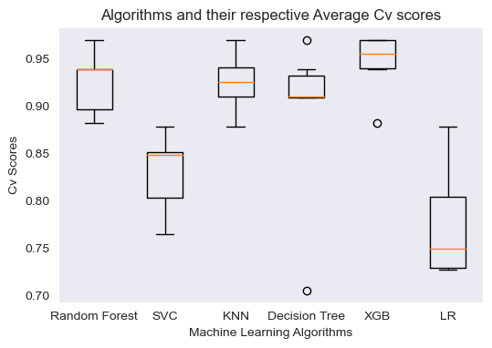
Model Training and Evaluation
After several Algorithms were trained, XgboostClassifier performed the best with the highest median cv score.

Slide 11
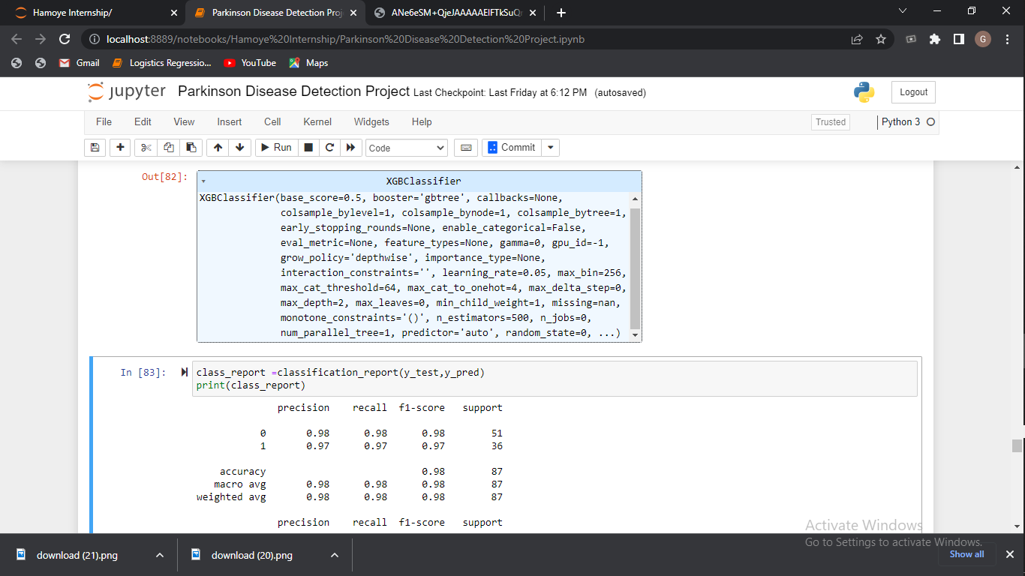
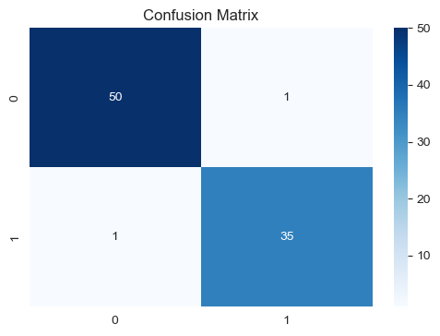
Hyperparameter Tuning
Following the previous model fine-tuning to ascertain which of the algorithm perform best in which Xgboost gave the best performance. We went further to improve on the Xgboost model by carrying out Hyperparameter tuning.
We used the GridSearchCV to tune parameters such as ‘n_estimators’, ‘max_depth’ and ‘learning_rate’ . Ultimately, it discovered the best tuning parameters to be (n_estimators =500, learning_rate=0.05, max_depth=2).
Using these metrics recall, precision and accuracy score showed there was no improvement on the model.

Slide 12
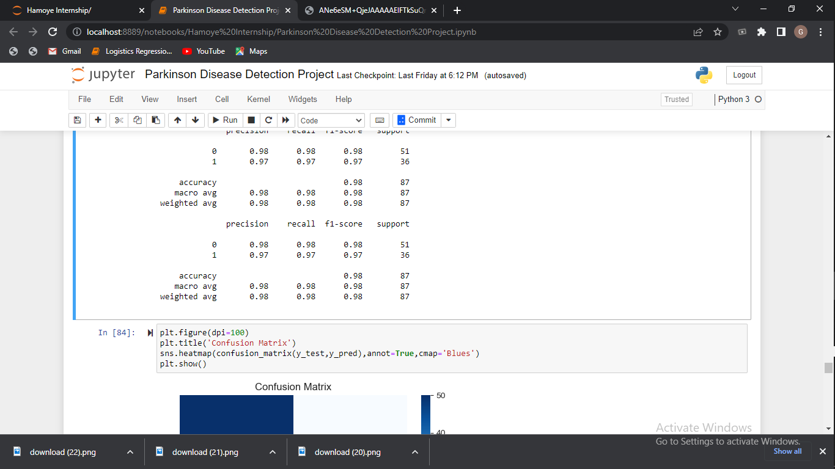
Evaluation Results
The accuracy score for the model is 0.98. but the accuracy score is not as suitable for imbalanced dataset.
The recall score shows the model performed at 97% for positive cases. This means out of all patients predicted to be diagnosed with Parkinson, 97% actually did have Parkinson. The same could be said about the precision score.

Slide 13
Limitation of Study
01
02
03
Class Imbalanced
The original dataset was 195 but while handling it’s imbalanced state we had to oversample the no Parkinson records and the total dataset increased to 287 records.
Selecting the Suitable algorithm
During the course of this project we tried 8 different algorithms and selected the one that performed consistently in all iterations.
For the best performing algorithm which is the Xgboost Classifier we did Hyperparameter Tuning for further improvement.
Selecting the Suitable Features for the Model
We did an extensive Exploratory Data Analysis so as to get the much needed insight about the relevant features affecting the target variable . This enabled us to drop some of the features.
From the tuned Xgboost model, we found the top features with the help of the feature importance function.

Slide 14
Conclusion
After trying out several Algorithms, the Xgboost Classifier proved to be the best and the most consistent in all iterations. In order to improve the model hyperparameter tuning was carried out. The model’s accuracy of detecting Parkinson disease was 98% with the f1_scores of 0.98. All of this points towards the model being viable enough to predict Parkinson Disease.
As we continue to expand our knowledge on this field, we would like to train our model on a larger dataset which could include a feature like age and race.

Slide 15
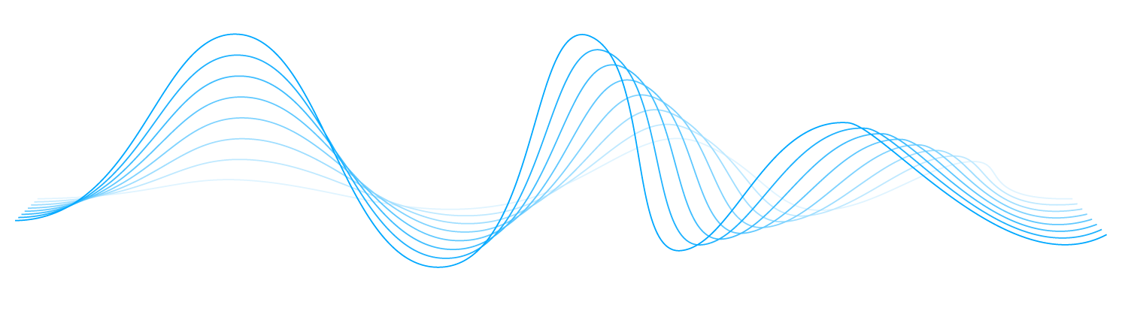
Thanks for Watching

